Slide 1

Topic 6: Data Transformation with dplyr – Part 2

Slide 2
Course Overview
Topic | Description
Session 1
1 | Introduction to R and R Studio Cloud
2 | Exploratory Data Analysis: the tibble and ggplot2
3 | Functions, Vectors and Lists
4 | Introduction to Functionals with purrr
5 | Data Transformation I with dplyr
Session 2
6 | Data Transformation II with dplyr
7 | Statistical Transformation with ggplot2
8 | Advanced Functionals and Modelling with purrr
9 | Exploratory Data Analysis - Case Study using aimsir17

Slide 3
Lecture Overview
Relational data in dplyr
Mutating joins
Filtering joins
tidyr overview
pivot_longer()
pivot_wider()
separate()

Slide 4
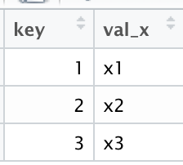
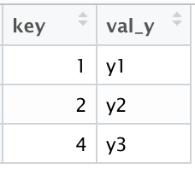
(1) Relational Data with dplyr
Typically, data analysis involves many tables of data that must be combined to answer questions
Collectively, multiple tables of data are called relational data
Relations are always defined between a pair of tables

Slide 5
Keys
The variables used to connect each pair of tables are called keys
A key is a variable (or set of variables) that uniquely identifies an observation
There are two types of keys:
A primary key uniquely identifies an observation in its own table
A foreign key uniquely identifies an observation in another table.

Slide 6
(2) Mutating Joins
Allows you to combine variables from two tables
First matches observations by their keys, and then copies across variables from one table to another
Similar to mutate(), the join functions add variables to the right

Slide 7
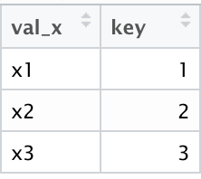
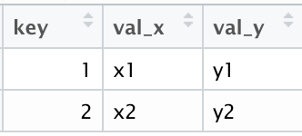
Join Types
Inner Join:
matches pairs of observations when their keys are equal
Unmatched rows are not included in the result
inner_join(x,y,by="key")

Slide 8
Outer Joins
An outer join keeps observations that appear in at least one of the tables. There are three types of outer joins (x,y)
A left join keeps all observations in x
A right join keeps all observations in y
A full join keeps all observations in x and y

Slide 9
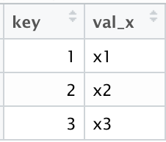
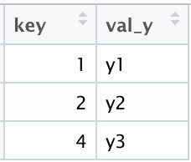
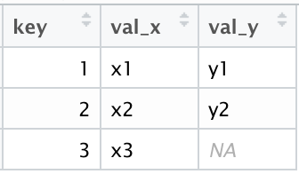
Left Join
left_join(x,y,by="key")

Slide 10
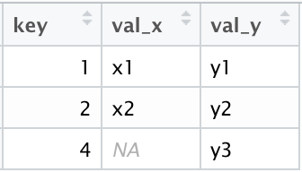
Right Join
right_join(x,y,by="key")

Slide 11
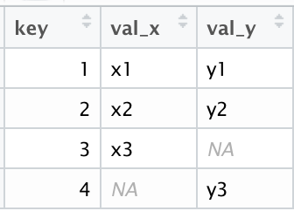
Full Join
full_join(x,y,by="key")

Slide 12
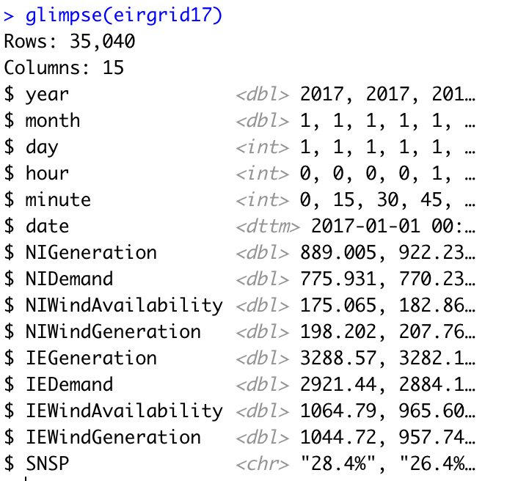
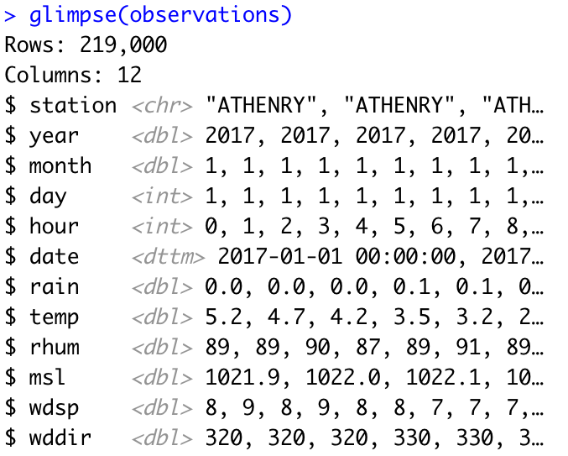
Aimsir17 – common keys

Slide 13
Challenge 6.1 – left_join
For October 2017, filter all observations for mace head
Create hourly observations (mean) of wind energy generated
Join the data sets
Plot the wind speed v wind energy generated, and add a model (also use jitter to show more points)

Slide 14
(3) Filtering Joins
Match observations in the same way as mutating joins, but affect the observations, not the variables
Two types:
semi_join(x,y) keeps all observations in x that have a match in y
anti_join(x,y), drops all observations in x that have a match in y.

Slide 15
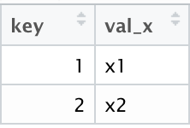
Semi Join
semi_join(x,y,by="key")
keeps all observations in x that have a match in y

Slide 16
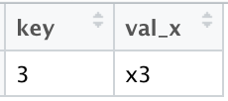
Anti Join
anti_join(x,y,by="key")
drops all observations in x that have a match in y

Slide 17
Challenge 6.2
Explore the relationship between minimum daily temperature and maximum daily electricity demand
Use three weather stations as examples: BELMULLET, DUBLIN AIPRORT and VALENTIA OBSERVATORY.

Slide 18
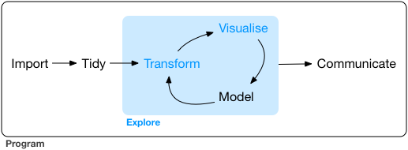
(4) Tidy Data - Overview
What is data tidying?
Structuring datasets to facilitate analysis
The tidy data standard is designed to:
Facilitate initial exploration and analysis of data
Simplify the development of data analysis tools that work well together
Principles closely related to relational algebra (Codd 1990)
Related packages: tidyr, ggplot2, dplyr

Slide 19
Why tidy data? (Wickham et al. p150)
Advantage to picking one consistent way of storing data. Easier to learn tools that work with tidy data because they have a underlying uniformity
Specific advantage to placing variables in columns because it allows R’s vectorised functions to shine.
dplyr, ggplot2 designed to work with tidy data

Slide 20
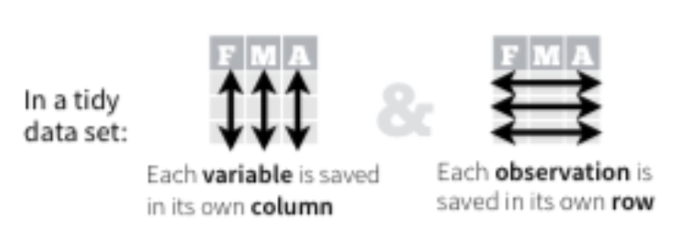
Rules for a Tidy Dataset
Each variable must have its own column
Each observation must have its own row
Each value must have its own cell
Put every dataset in a tibble
Put each variable in a column
https://rpubs.com/bradleyboehmke/data_wrangling

Slide 21
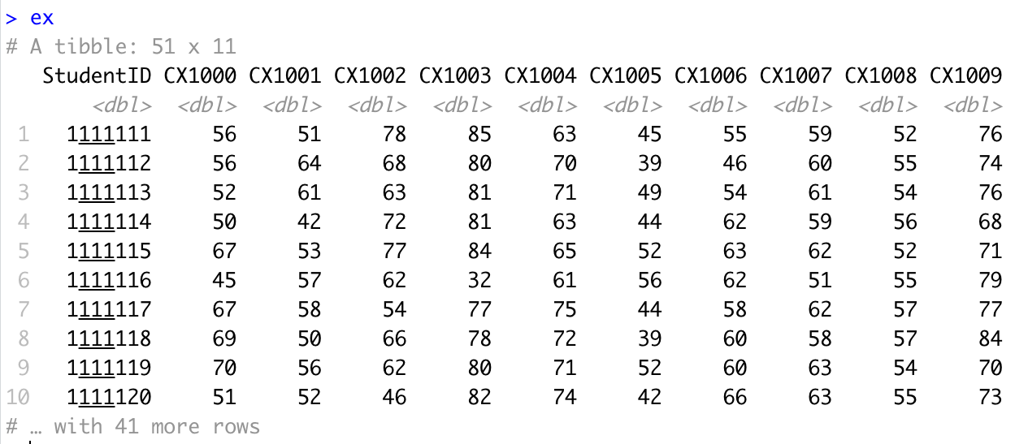
Example in R – untidy data

Slide 22
Identify the variables
Variables
Student
Subject
Result
https://rpubs.com/bradleyboehmke/data_wrangling

Slide 23
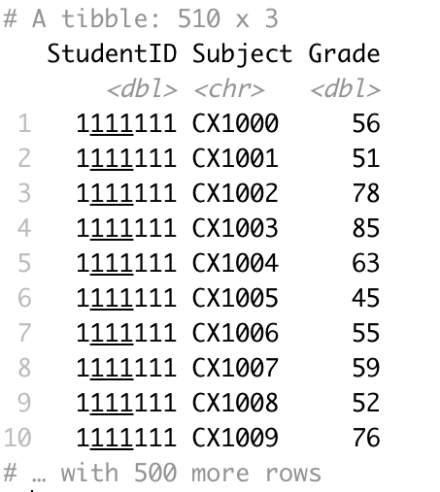
The goal…

Slide 24
tidyr package – sample functions of data tidying
pivot_longer() takes multiple columns, and gathers them into key-value pairs: it makes “wide” data longer
pivot_wider() takes two columns (key and value) and spreads into multiple columns, it makes long data wider
separate() splits a single column into multiple columns

Slide 25
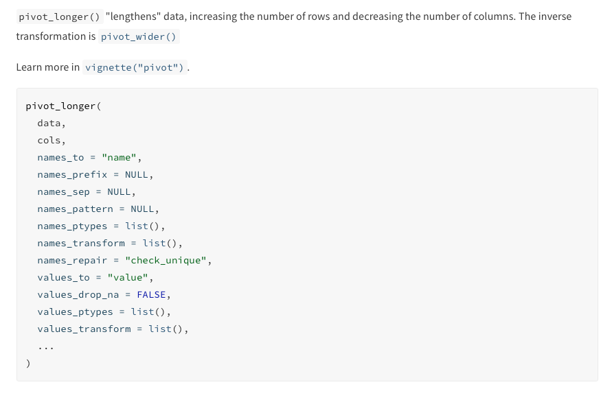
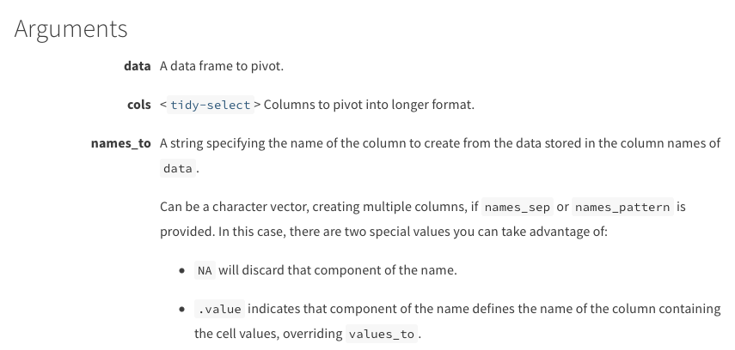
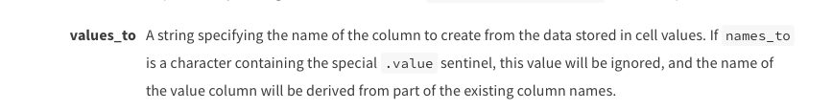
pivot_longer()

Slide 26
For example…

Slide 27
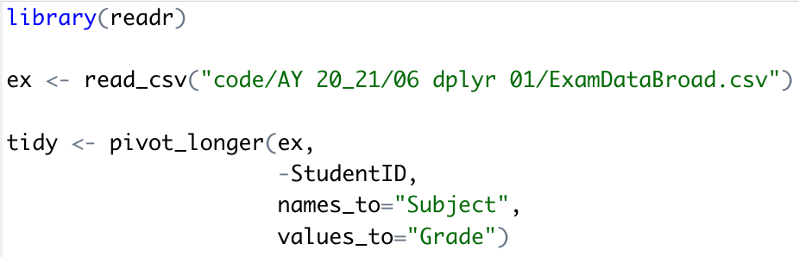
pivot_longer() Function call

Slide 28
Tidy data Supports data exploration

Slide 30
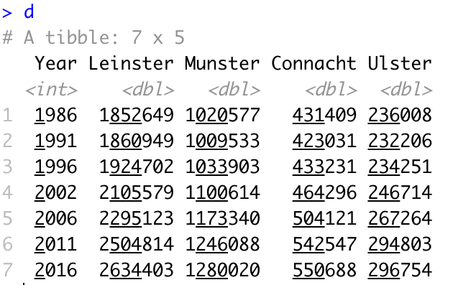
Challenge 6.3
Transform the census data to tidy format and create the following plot

Slide 31
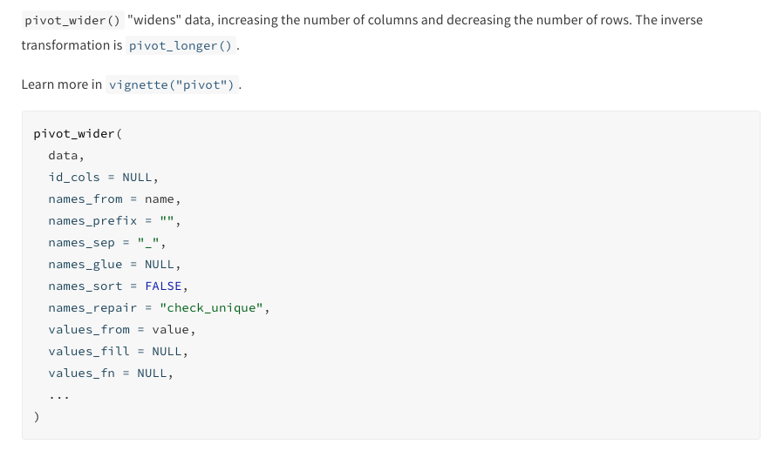
pivot_wider()
https://tidyr.tidyverse.org/reference/pivot_wider.html

Slide 32
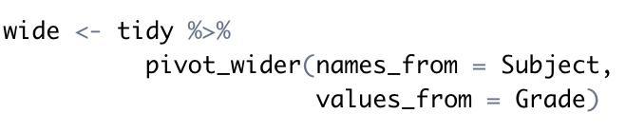
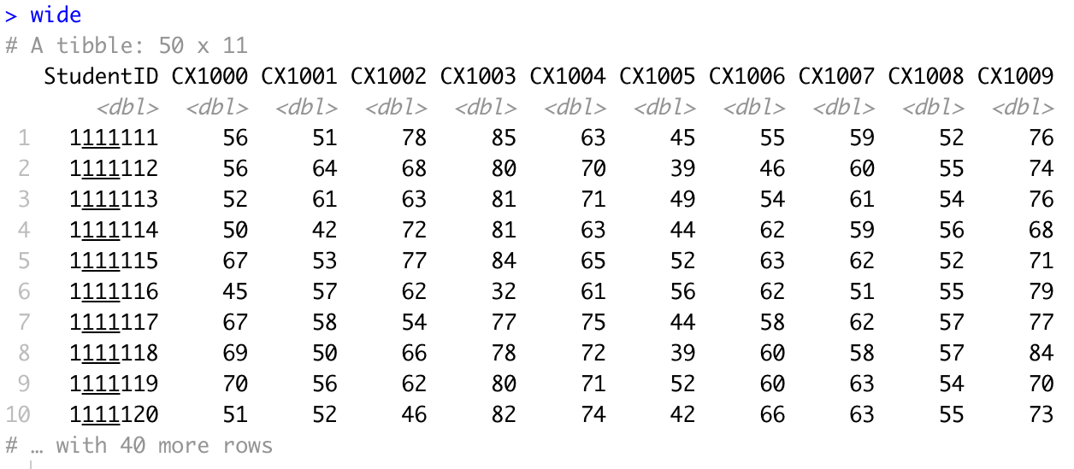

Slide 33
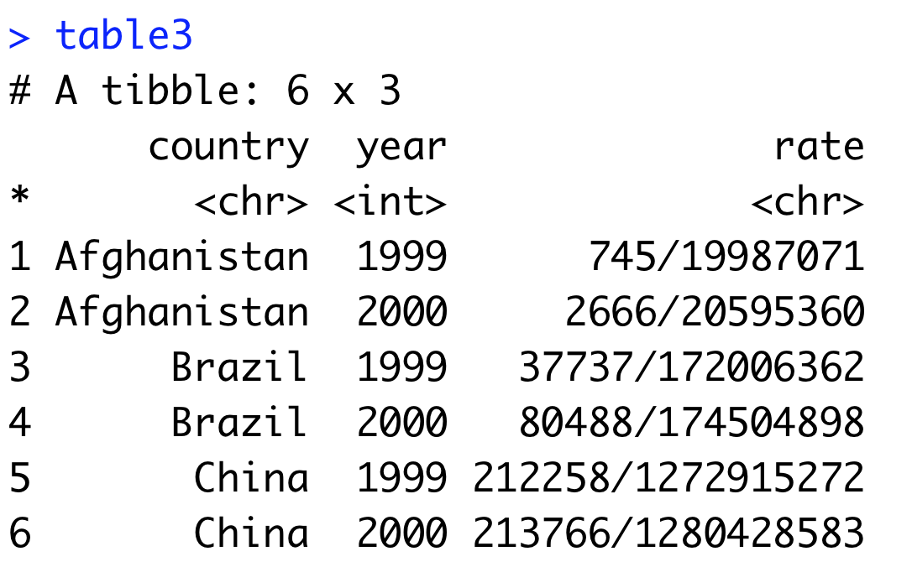
separate()
Separate pulls apart one column into multiple columns
It splits the information based on finding a non-alphanumeric character
Separator can be defined (sep=“/”)
A converter can find best type for the result, if needed.

Slide 34
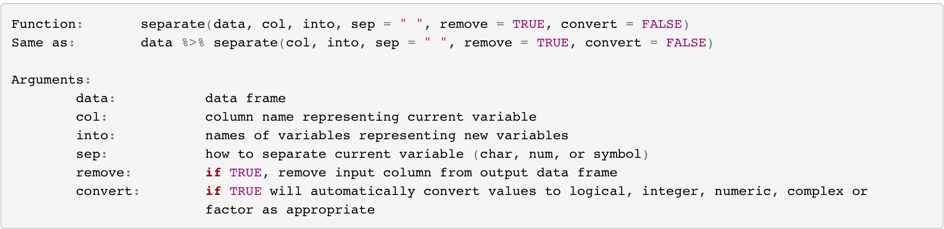
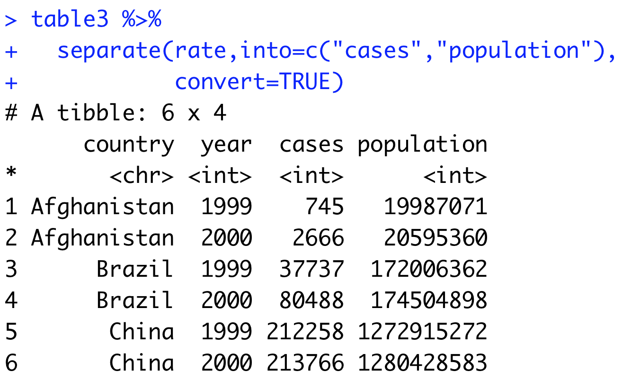

Slide 35
Topic 7: Statistical Transformations with ggplot2

Slide 36
Course Overview
Topic | Description
Session 1
1 | Introduction to R and R Studio Cloud
2 | Exploratory Data Analysis: the tibble and ggplot2
3 | Functions, Vectors and Lists
4 | Introduction to Functionals with purrr
5 | Data Transformation I with dplyr
Session 2
6 | Data Transformation II with dplyr
7 | Statistical Transformation with ggplot2
8 | Advanced Functionals and Modelling with purrr
9 | Exploratory Data Analysis - Case Study using aimsir17

Slide 37
Defining Important Terms (Wickham and Grolemund)
Term | Explanation
Variable | A quantity, quality or property that you can measure
Value | The state of a variable when you measure it. The value of a variable may change from measurement to measurement
Observation (or case) | A set of measurements made under similar conditions (you usually make all of the measurements in an observation at the same time and on the same object). An observation will contain several values, each associated with a different variable.
Tabular data | A set of values, each associated with a variable and an observation. Tabular data is tidy if each value is placed in its own “cell”, each variable in its own column, and each observation in its own row. All the data in aimsir17 and ggplot2 is tidy data.

Slide 38
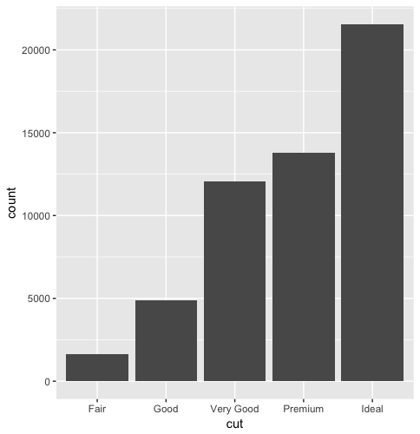
Variation
Bar Chart of Diamonds Data
Variation is the tendency of the values of a variable to change from measurement to measurement
If you measure a continuous variable twice, you can get two different results
For example, temperature at 12.00 and temperature at 13.00
Very variable has its own pattern of variation
The best way to understand the pattern is to visualize the distribution of a variable’s values.

Slide 39
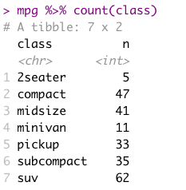
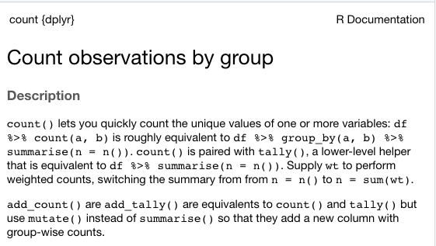
Useful function → dplyr::count()

Slide 40
Statistical Transformations
Many graphs, like scatterplots, plot the raw values of the dataset
However, other graphs (e.g. bar charts) calculate new values to plot
Bar charts, histograms and frequency polygons bin your data and plot bin counts, the number of points that fall in each bin
Smoothers fit a model to your data and the plot predictions from the model
Boxplots compute a robust summary of the distribution and display a specially formatted box

Slide 41
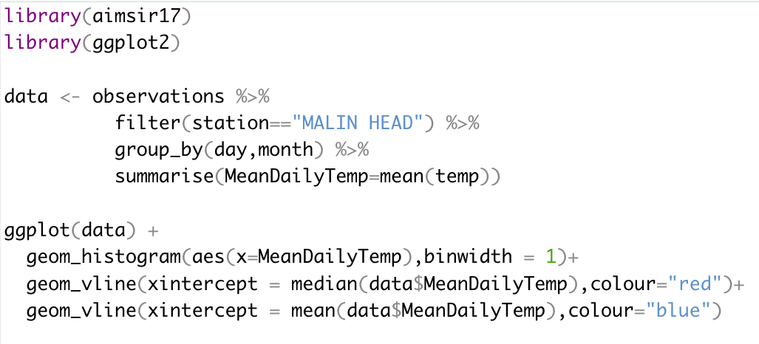
Histograms
A variable is continuous if it can take on any of an infinite set of ordinal values
Numbers are an example of a continuous variable
To examine the distribution of a continuous variable, use a histogram

Slide 42
Variation - Histogram
A histogram divides the x-axis into equally spaced bins, and uses the height of each bar to display the number of observations that fall into each bin
On the right, the total sum of all observation counts is 365.
The bin width can be varied.
geom_freqpoly() can also be used

Slide 43
Histogram - Interpretation
Tall bars show the common values of a variable, shorter bars show less common values
Places with no bars reveal values that were not seen in your data
Some useful questions
Which values are most common? Why?
Which values are rare? Does it match your expectation?
Can you see any unusual patterns? What might explain them?

Slide 44
Challenge 9.1
Generate a histogram for maximum daily windspeed (MACE HEAD)

Slide 45
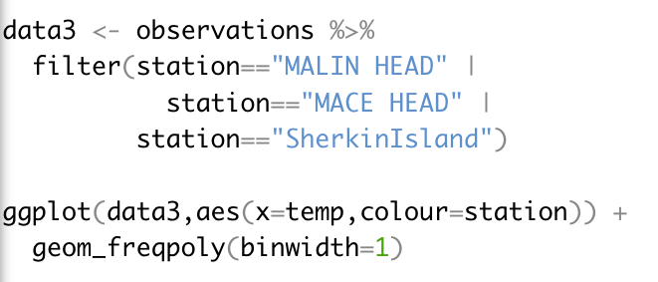
Two Station Comparison – geom_freqpoly()

Slide 46
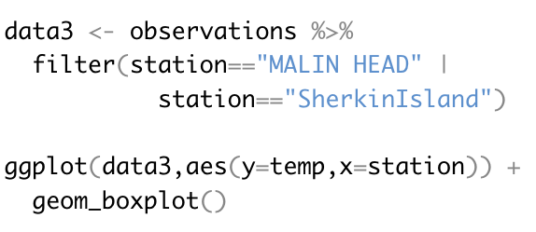
Comparing Distributions - boxplot

Slide 47
Covariation
If variation describes the behaviour within a variable, covariation describes the behaviour between variables
Covariation is the tendency for the values of two or more variables to vary together in a related way.
The best way to spot covariation is to visualize the relationship between two or more variables
We will explore covariation between continuous variables

Slide 48
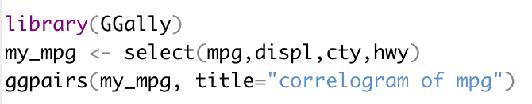
mpg data set

Slide 49
Challenge 9.2

Slide 50
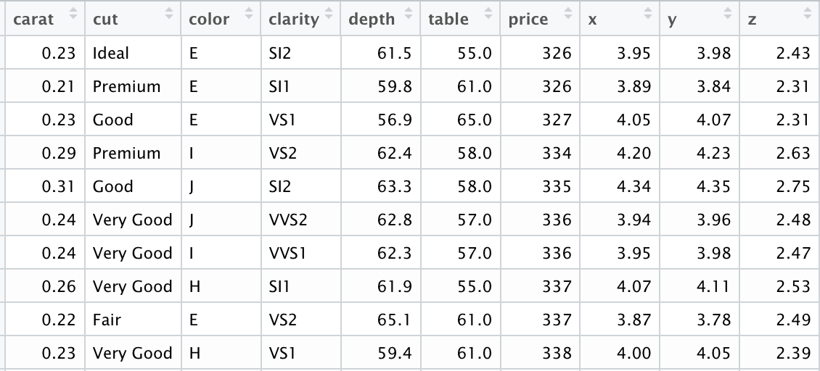
diamonds data set (ggplot2)
A dataset containing the prices and other attributes of almost 54,000 diamonds.

Slide 51
Explanation of variables
Feature | Explanation
price | price in US dollars $326–$18,823
carat | weight of the diamond (0.2–5.01)
cut | quality of the cut (Fair, Good, Very Good, Premium, Ideal)
color | diamond colour, from J (worst) to D (best)
clarity | a measurement of how clear the diamond is (I1 (worst), SI1, SI2, VS1, VS2, VVS1, VVS2, IF (best))
x | length in mm (0–10.74)
y | width in mm (0–58.9)
z | depth in mm (0–31.8)
depth | total depth percentage = z / mean(x, y) = 2 * z / (x + y) (43–79)
table | width of top of diamond relative to widest point (43–95)

Slide 52
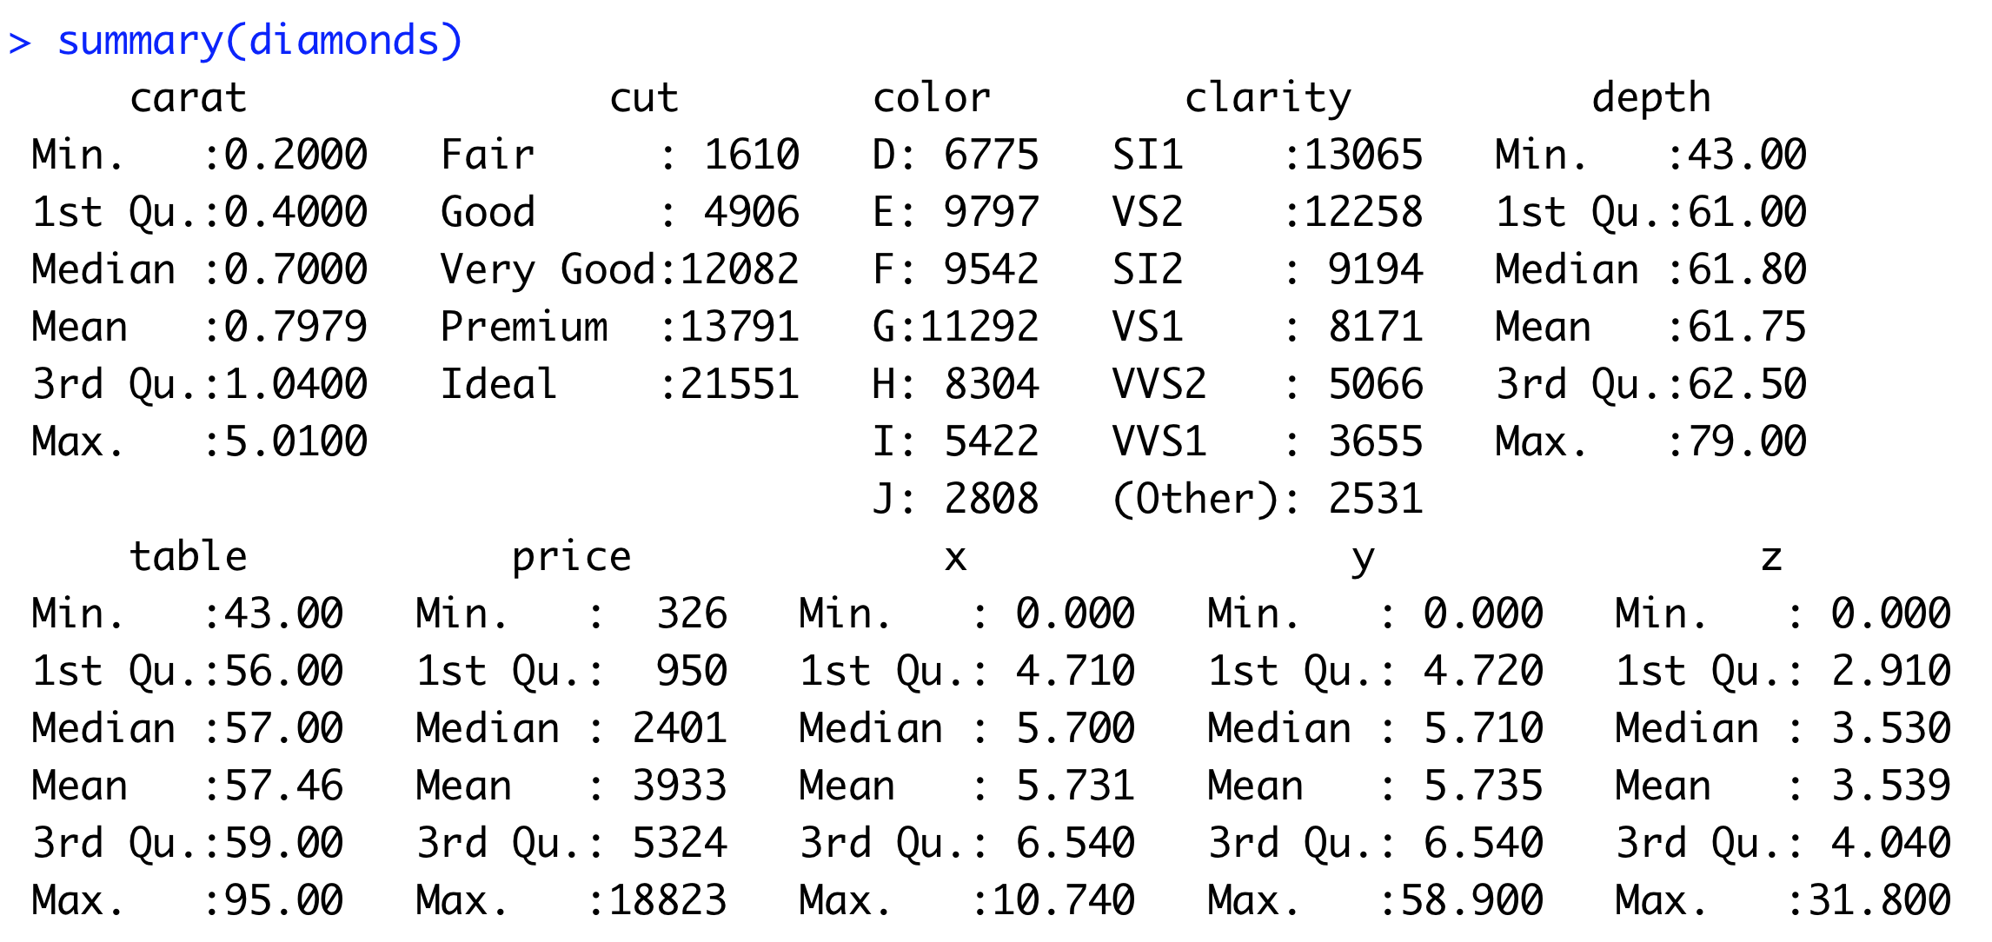
Summary of dataset

Slide 53
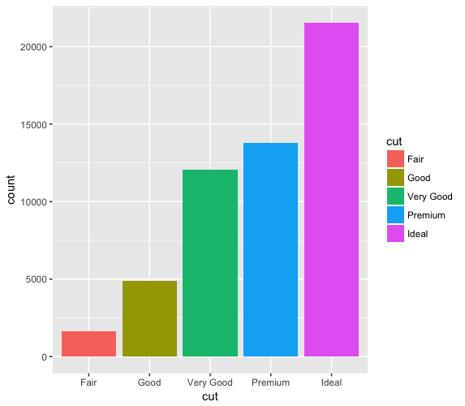
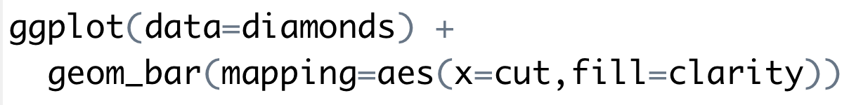
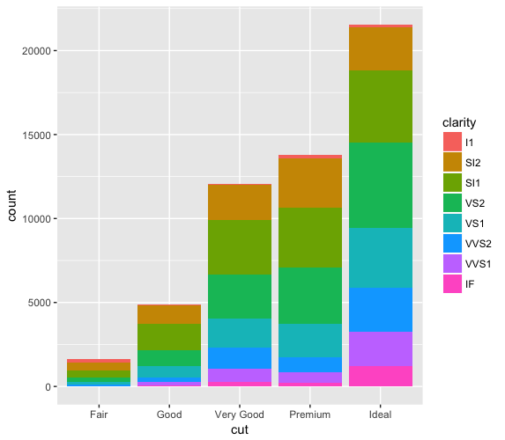
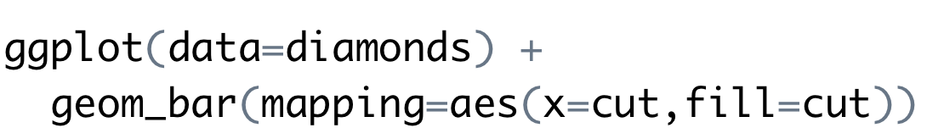
fill aesthetic for bar charts
Bar charts can be coloured using the fill aesthetic
When a different variable is used, the graph has further detail

Slide 54
Stacking options
Stacking is performed automatically by the position adjustment specified by the position argument
Examples include “identity”, “fill” and “dodge”
“fill”
Works like stacking, but each stacked bar is the same height
Makes it easier to compare proportions
“dodge”
Places objects directly beside one another
Makes it easier to compare individual values

Slide 55
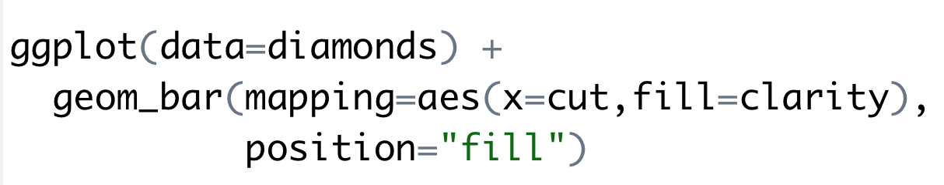
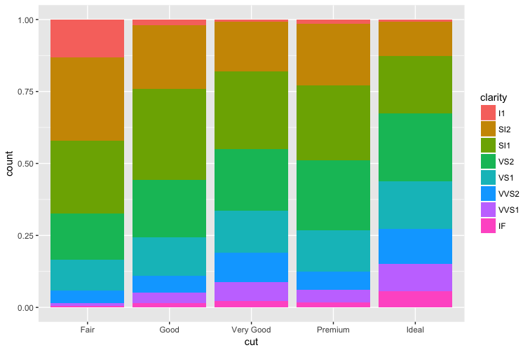

Slide 56
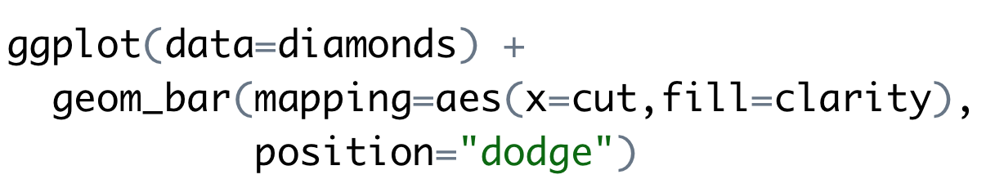
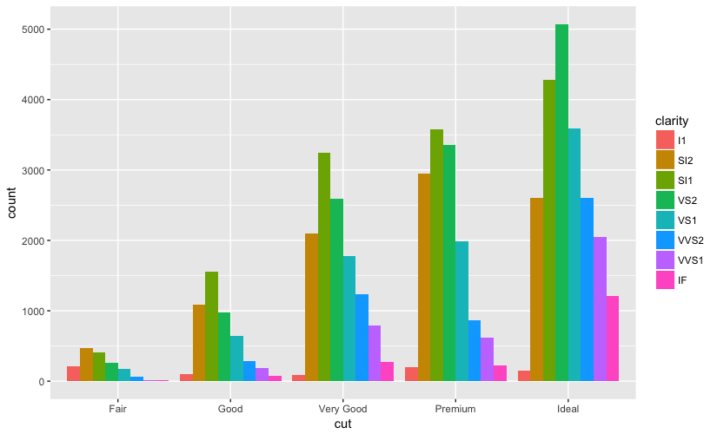

Slide 57
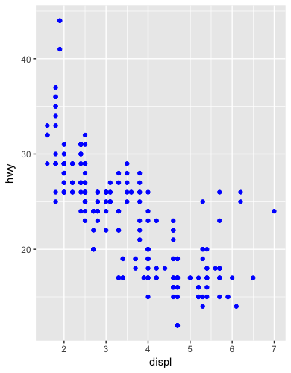
Additional adjustment
Recall our first scatterplot
126 points displayed, yet there are 234 observations
Many points can overlap, so it makes it hard to see where the mass of data is
Are all points spread equally, or is there one special combination that contains 129 values?
“jitter” adds random noise to each point.

Slide 58
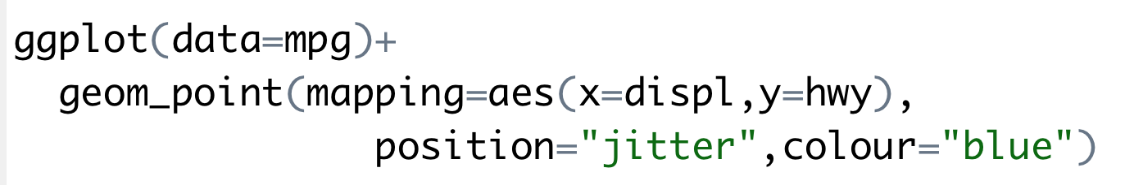
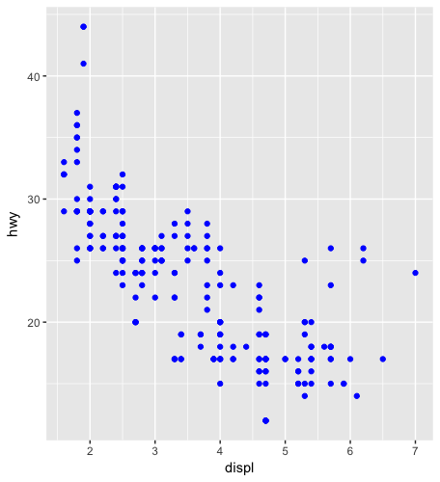
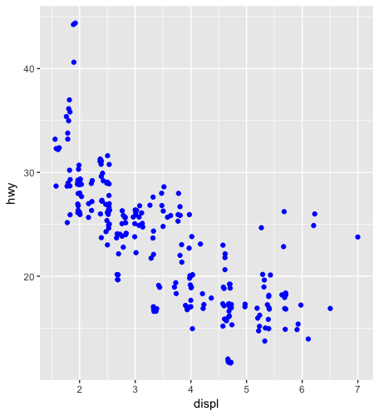

Slide 59
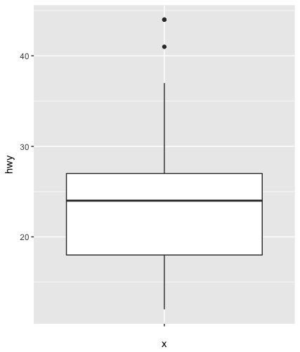
Boxplot
Display the distribution of a continuous variable broken down by a categorical variable
Box that stretches from the 25th to 75th percentile a distance known as the interquartile range (IRQ)
Median in the middle of box
Points outside more that 1.5 times the IQR from either edge of the box are displayed (outliers)
Whisker extends to the farthest non-outlier point in the distribution

Slide 60



Slide 61
The Layered Grammar of Graphics
The ggplot2 approach can be summarised by a template
It can take seven parameters, but usually not all need to be applied (defaults used)
These seven parameters compose the grammar of graphics
ggplot(data=<DATA>) +
<GEOM_FUNCTION>(
mapping=aes(<MAPPINGS>),
stat=<STAT>,
position=<POSITION>
) +
<COORDINATE_FUNCTION>+
<FACET_FUNCTION>

Slide 62
Challenge 7. aimsir17 Exploration
Use the data set in aimsir17 to generate:
Time series data
Scatter plot
Bar charts
Box plots
Histograms
Enhance the graphs using aesthetics such as colour, fill, size
Break out the graphs using the facet_ functions

Slide 63
Summary
“Data exploration is the art of looking at your data, rapidly generating hypotheses, quickly testing them, then repeating again and again and again.” (Wickham and Grolemund 2017).

Slide 64
Topic 8: Functionals and Modelling with purrr

Slide 65
Course Overview
Topic | Description
Session 1
1 | Introduction to R and R Studio Cloud
2 | Exploratory Data Analysis: the tibble and ggplot2
3 | Functions, Vectors and Lists
4 | Introduction to Functionals with purrr
5 | Data Transformation I with dplyr
Session 2
6 | Data Transformation II with dplyr
7 | Statistical Transformation with ggplot2
8 | Functionals and Modelling with purrr
9 | Exploratory Data Analysis - Case Study using aimsir17

Slide 66

Introduction to purrr
http://www.rebeccabarter.com/blog/2019-08-19_purrr/
purrr is all about iteration.
purrr introduces map functions (the tidyverse’s answer to base R’s apply functions, but more in line with functional programming practices) as well as some new functions for manipulating lists

Slide 67
Introduction to purrr
http://www.rebeccabarter.com/blog/2019-08-19_purrr/
While the workhorse of dplyr is the data frame, the workhorse of purrr is the list.
A vector is a way of storing many individual elements (a single number or a single character or string) of the same type together in a single object,
A data frame is a way of storing many vectors of the same length but possibly of different types together in a single object
A list is a way of storing many objects of any type (e.g. data frames, plots, vectors) together in a single object

Slide 68

(1) Map functions
A map function is one that applies the same action/function to every element of an object (e.g. each entry of a list or a vector, or each of the columns of a data frame)
The naming convention of the map functions are such that the type of the output is specified by the term that follows the underscore in the function name
Consistent with the way of the tidyverse, the first argument of each mapping function is always the data object that you want to map over, and the second argument is always the function that you want to iteratively apply to each element of the input object

Slide 69

map_df()
If you want to return a data frame, then you would use the map_df() function.
However, you need to make sure that in each iteration you’re returning a data frame which has consistent column names.
map_df will automatically bind the rows of each iteration.

Slide 70

(2) The tilde-dot shorthand for functions
To make the code more concise you can use the tilde-dot shorthand for anonymous functions (the functions that you create as arguments of other functions).
~ indicates that you have started an anonymous function, and the argument of the anonymous function can be referred to using .x (or simply .).
Unlike normal function arguments that can be anything that you like, the tilde-dot function argument is always .x.

Slide 71

gapminder package
The gapminder dataset has 1704 rows containing information on population, life expectancy and GDP per capita by year and country.
It’s in tidy data format
http://www.rebeccabarter.com/blog/2019-08-19_purrr/

Slide 72

Analysing gapminder
Since gapminder is a data frame, the map_ functions will iterate over each column.
An example of simple usage of the map_ functions is to summarize each column.
For instance, you can identify the type of each column by applying the class() function to each column.
Since the output of the class() function is a character, we will use the map_chr() function:

Slide 73

Further analysis
http://www.rebeccabarter.com/blog/2019-08-19_purrr/
Similarly, if you wanted to identify the number of distinct values in each column, you could apply the n_distinct() function from the dplyr package to each column.
Since the output of n_distinct() is a numeric (a double), you might want to use the map_dbl() function so that the results of each iteration (the application of n_distinct() to each column) are concatenated into a numeric vector:

Slide 74


If you want to do something a little more complicated, such return a few different summaries of each column in a data frame, you can use map_df().
You typically need to define an anonymous function that you want to apply to each column.
Using the tilde-dot notation, the anonymous function calculates the number of distinct entries and the type of the current column (which is accessible as .x), and then combines them into a two-column data frame.
Once it has iterated through each of the columns, the map_df function combines the data frames row-wise into a single data frame.

Slide 75

Adding the variable name
http://www.rebeccabarter.com/blog/2019-08-19_purrr/
The variable names correspond to the names of the objects over which we are iterating (in this case, the column names), and these are not automatically included as a column in the output data frame.
You can tell map_df() to include them using the .id argument of map_df().
This will automatically take the name of the element being iterated over and include it in the column corresponding to whatever you set .id to

Slide 76


modify_if()
modify_if(), only applies the function to elements that satisfy a specific criteria (specified by a “predicate function”, the second argument called .p).
For instance, the following example only modifies the third entry since it is greater than 5.

Slide 77

Challenge 8.1
Generate the following tibble from aimsir17::observations, making use of map_df()

Slide 78
(3) Statistical Analysis - mpg

Slide 79

Getting to the details…

Slide 80



dplyr and purrr

Slide 81


A linear model, with some model results

Slide 82
Overall Approach
Group the data by class
For each class, calculate and record:
Number of observations
Class name
Intercept
Slope
RSquared
AdjRSquared
Return as a tibble

Slide 83

R Script

Slide 84
Challenge 8.2
Generate a similar tibble for the manufacturers in mpg.
For this example, use hwy as the dependent variable, and cyl as the independent variable
Check the results using ggplot() and geom_smooth()

Slide 85

(4) Nesting of Tibbles
Tibble columns can be lists (as opposed to vectors, which is what they usually are)..
For instance, a tibble can be “nested” where the tibble is essentially split into separate data frames based on a grouping variable, and these separate data frames are stored as entries of a list (that is then stored in the data column of the data frame).

Slide 86

Extracting data (pluck function)

Slide 87



Storing model results as a column

Slide 88





Slide 89
Challenge 8.3
Generate a similar set of models (25) for observations (by station), where wdsp is the dependent variable, and msl is the independent variable

Slide 90

(5) Generating Multiple Plots

Slide 91


Slide 92
Summary
map functions
~ anonymous function
Statistical analysis
nest() function
Generating multiple plots

Slide 93


Slide 94


Slide 95
Topic : Exploratory Data Analysis with aimsir17

Slide 96
Course Overview
Topic | Description
Session 1
1 | Introduction to R and R Studio Cloud
2 | Exploratory Data Analysis: the tibble and ggplot2
3 | Functions, Vectors and Lists
4 | Introduction to Functionals with purrr
5 | Data Transformation I with dplyr
Session 2
6 | Data Transformation II with dplyr
7 | Statistical Transformation with ggplot2
8 | Functionals and Modelling with purrr
9 | Exploratory Data Analysis - Case Study using aimsir17

Slide 97
Exploratory Data Analysis
“Data exploration is the art of looking at your data, rapidly generating hypotheses, quickly testing them, then repeating again and again and again.” (Wickham and Grolemund 2017).

Slide 98

Data Set (1) - observations

Slide 99

Data Set (2) - stations

Slide 100

Data Set (3) – eirgrid17

Slide 101
Exploratory Data Analysis - Samples
Weather (Pick 3 stations)
West v East v South, is there a difference in annual rainfall, temperature?
Overall
What is the driest month of the year?
Association between atmospheric pressure and rainfall?
Energy
Association between average temperature and energy demand?
Which weather station’s average wind speed produces the best linear model for wind energy generated.

